Slide 1
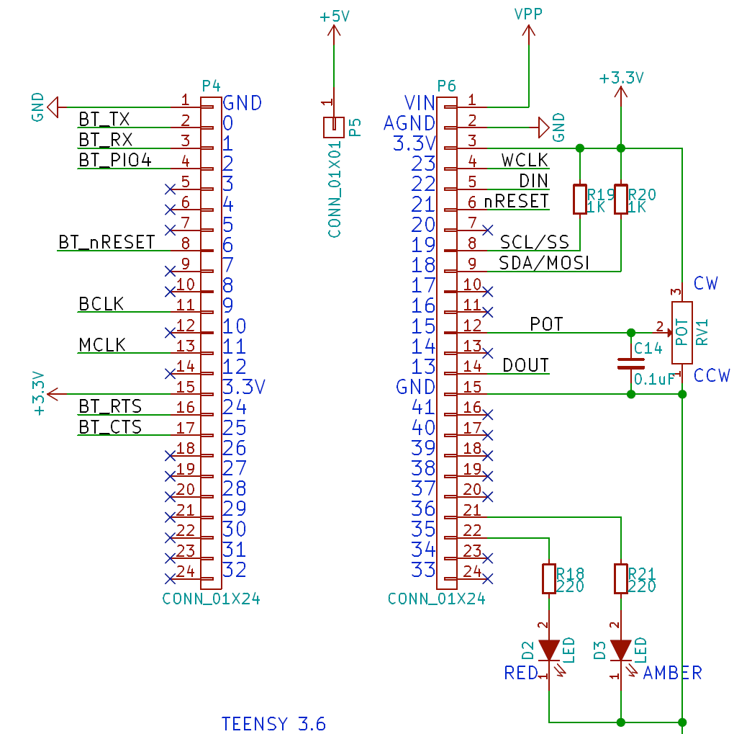
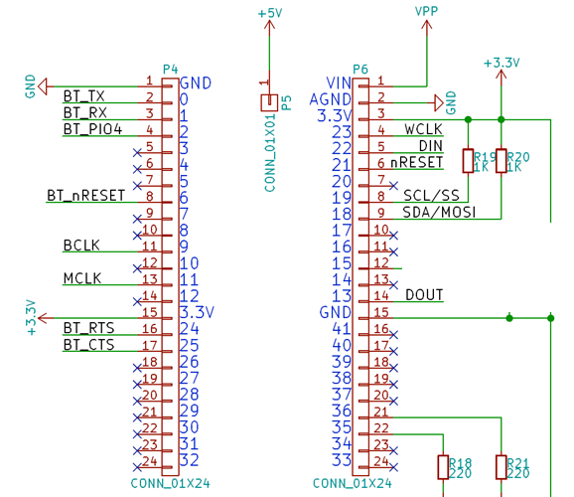
Tympan Rev C
Original
Tympan Rev C
Modified for 2 AICs
Can be any pin, really
SCL2 (AIC #2)
SDA2 (AIC #2)
nRESET1 (AIC#2)
Can be any analog pin
Pot Wiper
TXD1 (“DIN” AIC#2)
RXD1 (“DOUT” AIC#2)
TXD1 is PTC0
RXD1 is PTC11

Slide 2
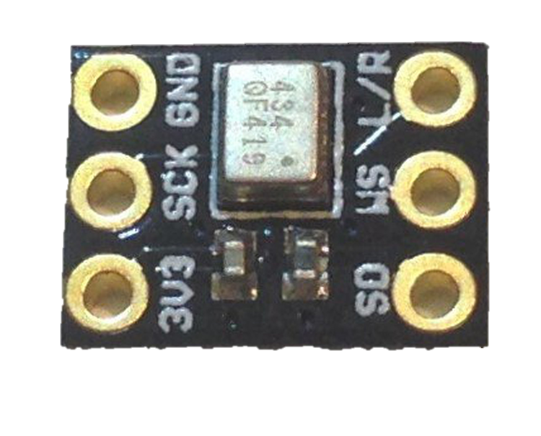
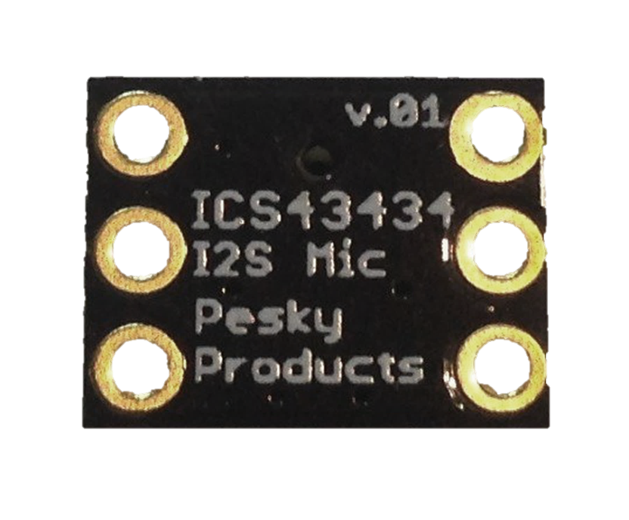
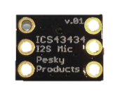
L/R
GND
WS
SCK
SD
3V3

Slide 3
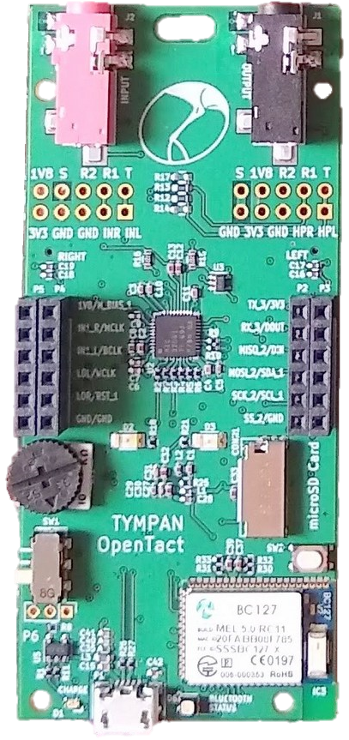
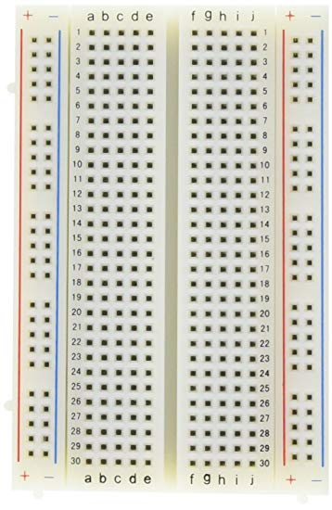
L/R
GND
WS
SCK
SD
3V3
L/R
GND
WS
SCK
SD
3V3
https://www.tindie.com/products/onehorse/ics43434-i2s-digital-microphone/

Slide 4
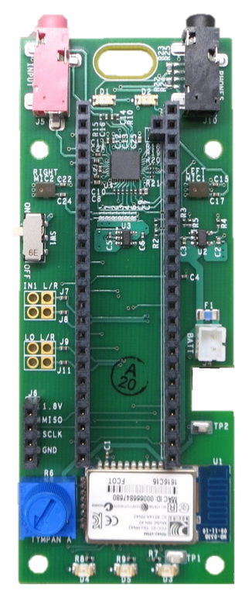
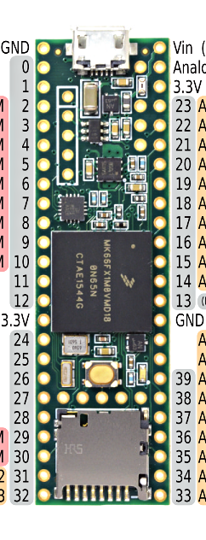
L/R
GND
WS
SCK
SD
3V3
L/R
GND
WS
SCK
SD
3V3
https://www.tindie.com/products/onehorse/ics43434-i2s-digital-microphone/

Slide 5
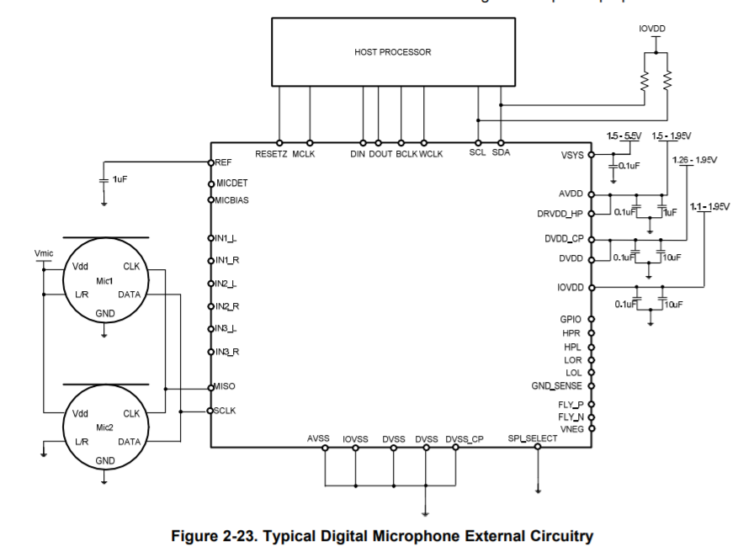
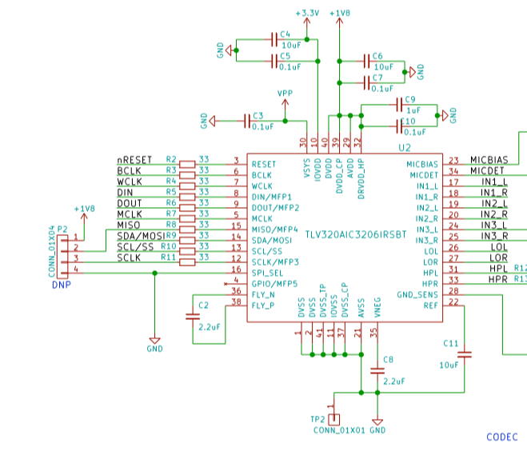
PDM Mics
Tympan Rev C
AIC3206 Application Guide
MFP4 (MISO)
MFP3 (SCLK)

Slide 6
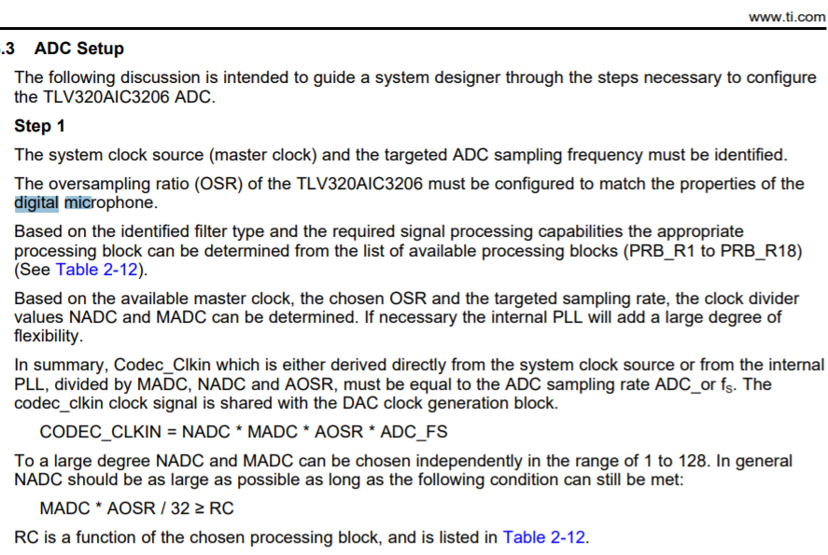
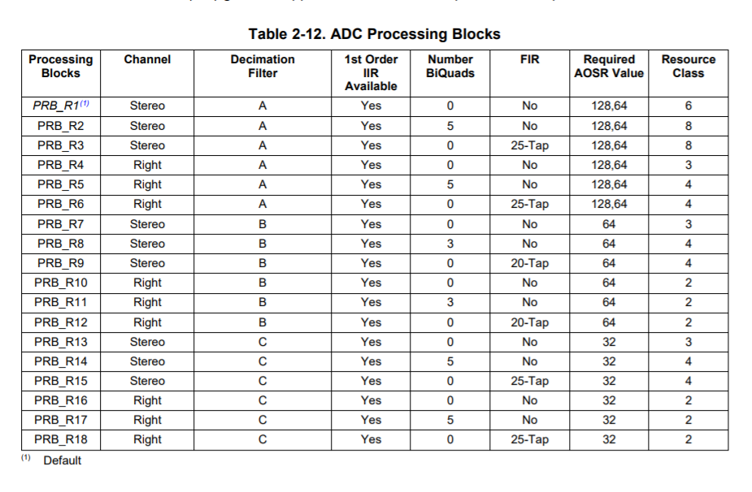
ADC Timing for Dig Mics

Slide 7
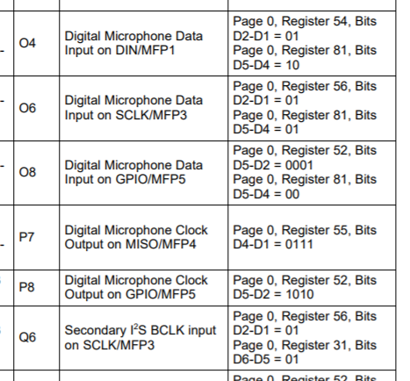
Setting the MFP pins

Slide 8
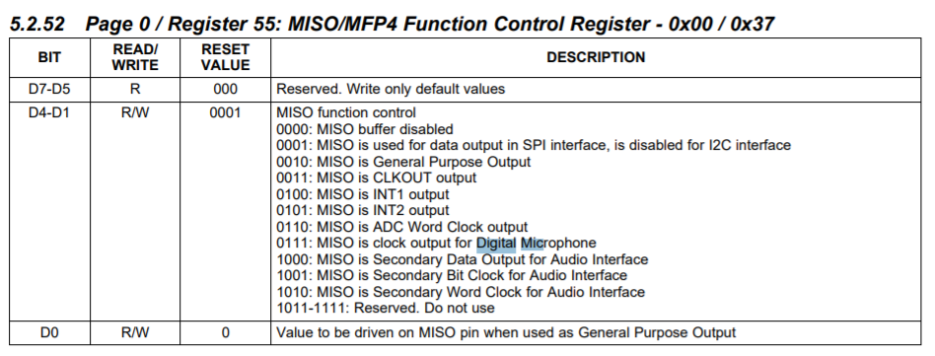
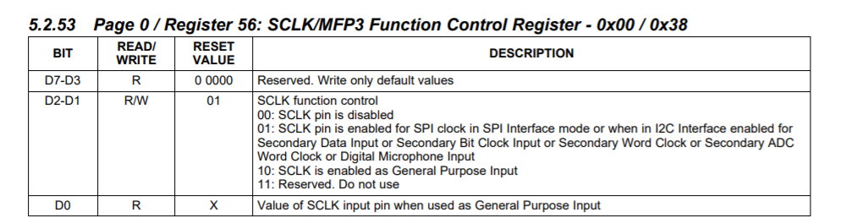
Digital Mic Registers

Slide 9
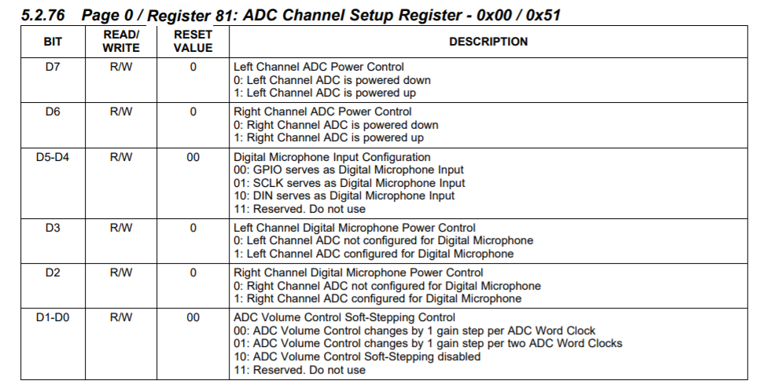
ADC Setup

Slide 10
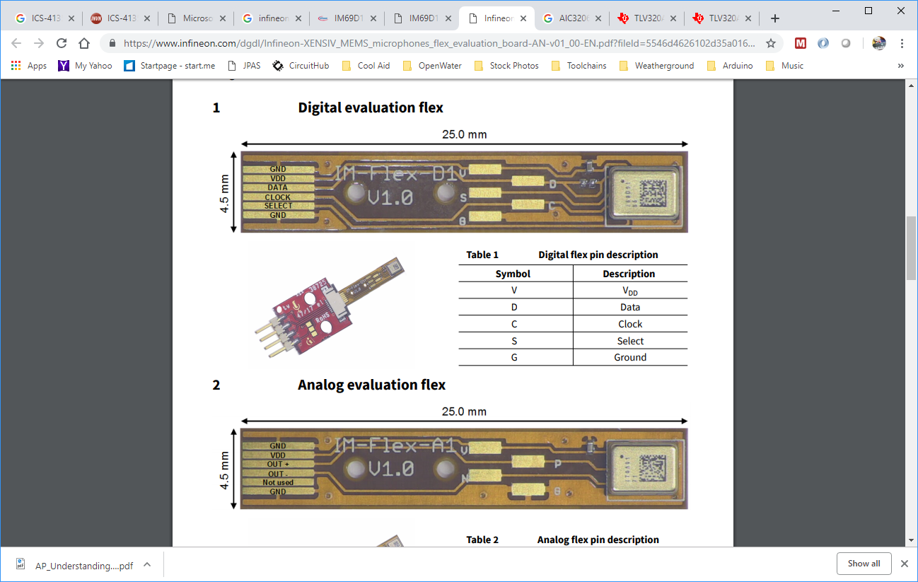
Infineon PDM Mic Dev Kit
Tympan Rev C
3.3V!
MICs
Mic Dev Kit
https://www.infineon.com/dgdl/Infineon-IM69D130-DS-v01_00-EN.pdf?fileId=5546d462602a9dc801607a0e46511a2e
https://www.infineon.com/dgdl/Infineon-XENSIV_MEMS_microphones_flex_evaluation_board-AN-v01_00-EN.pdf?fileId=5546d4626102d35a016128134576790d

